Slide 1
House of Flowers App Design
Nazeeya Azeem

Slide 2
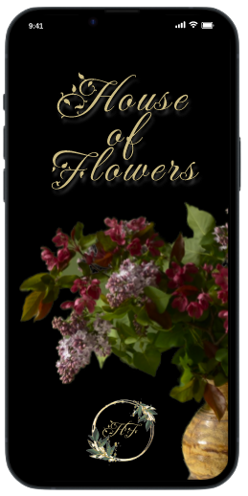
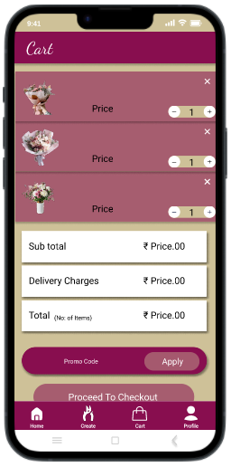
Project overview
The product:
House of Flowers app will let users buy flower bouquets online along with other items like confectionary, balloons etc. The app will affect how effortlessly customers can purchase gifts by giving customers a user interface with a short learning curve. They offer a wide spectrum of competitive pricing.
Project duration:
January 2022 to March 2022.

Slide 3
Project overview
The problem:
No bouquet preview app for users to know what will be delivered when ordering bouquets online
The goal:
Design an app for House of Flowers that allows users to easily order and pick up fresh flowers.

Slide 4
Project overview
My role:
UX designer designing an app for House of Flowers from conception to delivery.
Responsibilities:
Conducting interviews, paper and digital wireframing, low and high-fidelity prototyping, conducting usability studies, accounting for accessibility, and iterating on designs.

Slide 5
Understanding
the user
User research
Personas
Problem statements
User journey maps

Slide 6
User research: summary
I conducted interviews and created empathy maps to understand the users I’m designing for and their needs. A primary user group identified through research was working adults who didn't have time to go to a florist to buy flowers.
This user group confirmed initial assumptions about House of Flowers customers, but research also revealed that time was not the only factor limiting users from by bouquets and gifts online. Other user problems included obligations, interests, or challenges that make it difficult to get the right flowers or go to flower shops in-person

Slide 7
User research: pain points
1
2
3
Time
Accessibility
Quality
Lack of time to shop for flowers in person.
Difficulty finding a florist that has the right flowers for the occasion
Concerns about the quality of the flowers or the delivery time.

Slide 8
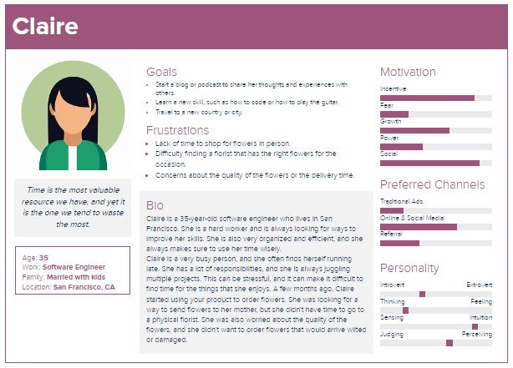
Persona: Claire
Problem statement:
Claire is a busy working adult who needs an easy and convenient way to order flower bouquets and gifts online because she has no time to go in-person.

Slide 9
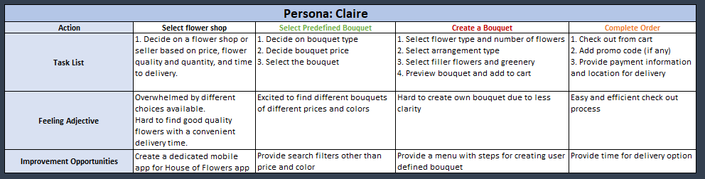
User journey map
Mapping Claire’s user journey revealed how helpful it would be for users to have access to a dedicated House of Flower’s app.

Slide 10
Starting
the design
Paper wireframes
Digital wireframes
Low-fidelity prototype
Usability studies

Slide 11
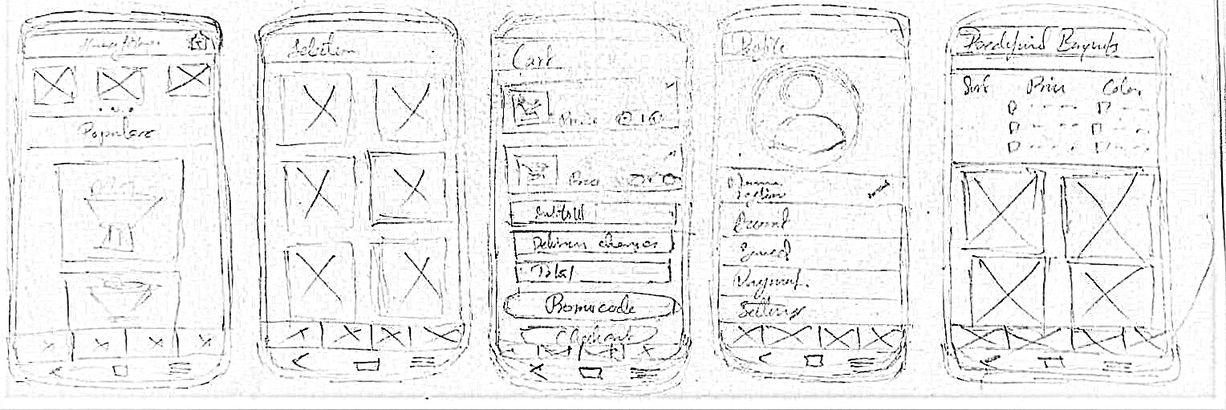
Paper wireframes
Taking the time to draft iterations of each screen of the app on paper ensured that the elements that made it to digital wireframes would be well-suited to address user pain points. The above wireframes show the home screen, cart, profile, a model of the selection menus, and sorting ready made bouquets based on price and color.

Slide 12
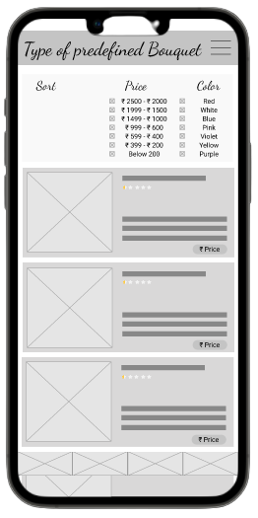
Digital wireframes
Sorting panel with checkboxes for sorting based on price and color
As the initial design phase continued, I made sure to base screen designs on feedback and findings from the user research.

Slide 13
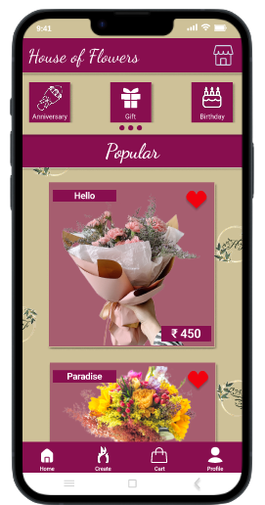
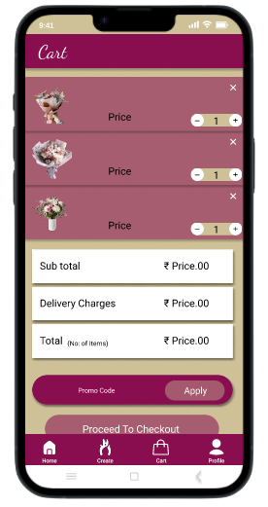
Digital wireframes
Easy navigation was a key user need to address in the designs as well as a convenient check out process.
Easy access to navigation

Slide 14
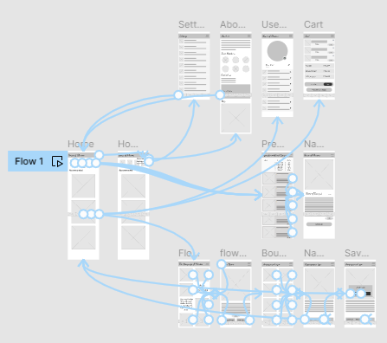
Low-fidelity prototype
Using the completed set of digital wireframes, I created a low-fidelity prototype. The primary user flow I connected was building and ordering a bouquet, so that the prototype could be used in a usability study.
View the House of Flowers low-fidelity prototype

Slide 15
Usability study: findings
I conducted two rounds of usability studies. Findings from the first study helped guide the designs from wireframes to mockups. The second study used a high-fidelity prototype and revealed what aspects of the mockups needed refining.
Round 1 findings
Round 2 findings
Users want to order bouquets quickly
“Build your own” functionality is confusing
1
1
Users want more options to sort flower bouquets
Option to add fillers and greenery when building bouquets
2
2
Option to save bouquets created by users and also to modify them
3
Option to choose time of delivery
3

Slide 16
Refining
the design
Mockups
High-fidelity prototype
Accessibility

Slide 17
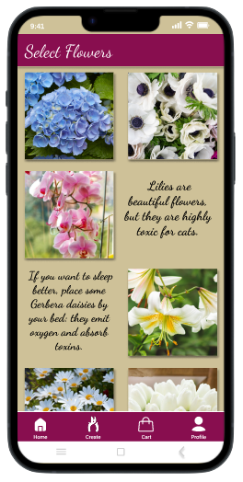
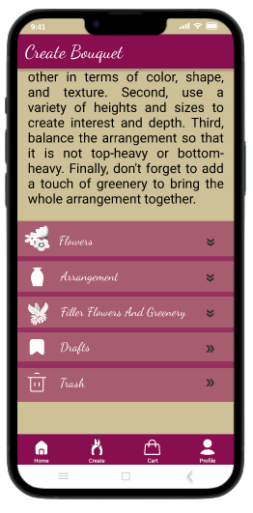
Mockups
Before usability studies
After usability studies
Early designs allowed for some customization, but after the usability studies, I added additional options to choose flowers, arrangement type and the filler flowers and greenery. I also revised the design so users see all the customization options when they first land on the screen.

Slide 18
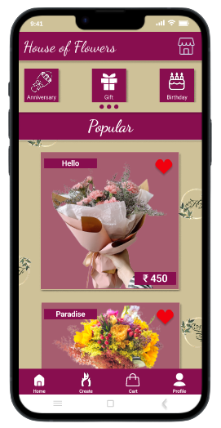
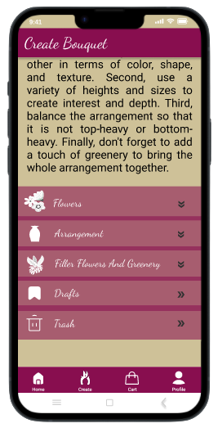
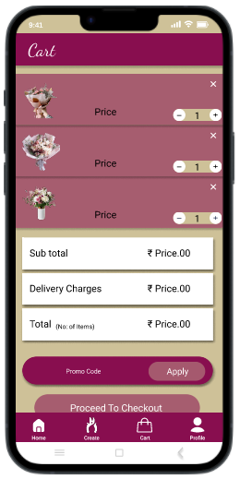
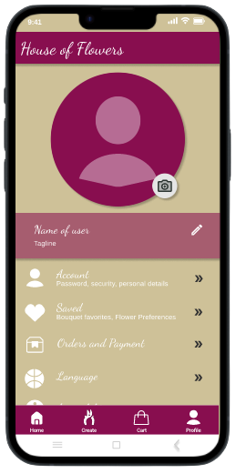
Key mockups

Slide 19
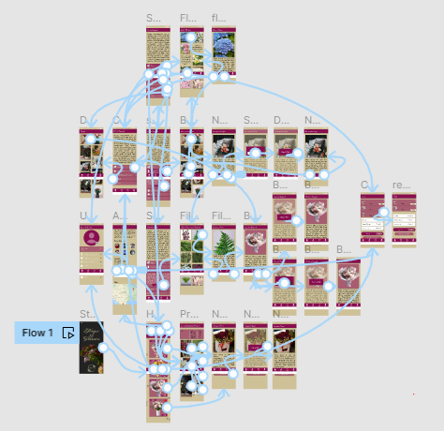
High-fidelity prototype
The final high-fidelity prototype presented cleaner user flows for selecting bouquets, building bouquets and checkout. It also met user needs for a an organised build your own bouquet option as well as more customization.
View the House of Flowers high-fidelity prototype

Slide 20
Accessibility considerations
1
2
3
Provided access to users who are vision impaired through adding alt text to images for screen readers.
Used icons to help make navigation easier.
Used detailed imagery for bouquets, flowers, arrangements, and fillers to help all users better understand the designs.

Slide 21
Going forward
Takeaways
Next steps

Slide 22
Takeaways
Impact:
The app makes users feel like House of Flowers really thinks about how to meet their needs.
One quote from peer feedback:
“The app made it so easy and fun to build my own bouquet! I would definitely use this app as a go-to for easy and convenient way to place bouquet orders.”
What I learned:
While designing the House of Flowers app, I learned that the first ideas for the app are only the beginning of the process. Usability studies and peer feedback influenced each iteration of the app’s designs.

Slide 23
Next steps
1
2
Conduct another round of usability studies to validate whether the pain points users experienced have been effectively addressed.
Conduct more user research to determine any new areas of need.

Slide 24
Thank You
Thank you for your time reviewing my work on the House of Flowers app!

